Slide 1
Classes
3D
Mrs Drage
3W
Miss Warren
Mrs Price is the year group LSA and works mornings and Monday afternoons

Slide 2
Main topics this year
Stone Age to Iron Age
Harry Potter
Blue Planet
The Romans

Slide 3
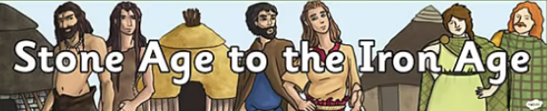
English
Our writing this term we will use a variety of Roald Dahl stories for inspiration; create a poem linked to a Stone Age creature; create a non-chronological report; use Stone Age Boy to inspire our writing and learn all about Mary Anning when writing a biography.
Year 3 Half Term 1 & 2 AUTUMN
Maths
In Maths this term, we will consolidate our previous learning of place value; methods for addition and subtraction; brush up on our mental maths skills.
Music
We will learn to sing and accompany ‘Three Little Birds’. We will learn carols leading up to Christmas.
RE
Children will learn more how people show their commitments to their religion and also the Holy Trinity.
Theme Overview- This term our learning will link to the Stone Age through to the Iron Age. We will welcome a visitor to help us to learn a little bit about the Stone Age.
French
During this term, we will learn basic greetings phrases.
PE
In PE, children will be developing their team skills. Additionally, we will be learning the skills needed to play the sport of basketball.
History
We will learn about what life was like in the Stone Age, Bronze Age and Iron Age.
Science
Within science this term, our topics are ‘Rocks and Soils’ and ‘Forces and Magnets’. We will learn all about how rocks and soils are formed. This also includes learning all about fossils!
Geography
We will learn about countries, counties and cities in the UK.
Art
In art, we will create work linked to the Stone Age including cave art.
PSHE
‘My healthy self’.
Looking at caring for both physical and mental health.
Computing
Within computing this term, we will be learning how computer systems work and begin to developing our coding skills.

Slide 4
PE ( Thursday AM and Friday PM)
PE kits (children will come to school in their kit)
  Suitable for going outdoors even in the autumn/winter
  Tracksuit/sweatshirt (black joggers)
  Trainers that the children can do up themselves
No earrings can be worn in PE lessons - children must be able to remove earrings themselves (or come to school with them already removed) otherwise they unfortunately will not br able to take part in PE lessons as stated in the Health and Safety Act.

Slide 5
School Equipment
Art apron - old shirt
Pencil case - small and labelled
Plastic homework folder
Ensure all clothes are labelled

Slide 6
Reading
Books will be changed at least once a week. Children still reading books from the phonics scheme will be given two books based on their most recent assessments. Children reading from the school scheme (Panda etc) will select their own books (and so may read more books in a week).
We encourage the children to read to an adult every evening for a short time. Asking your child questions about their reading is an easy but very effective way of building comprehension into the child’s reading.
We provide each child with a reading record where their current reading book is recorded. Please sign/initial when you have read with your child. Any notes or questions can be recorded in here as we will check them at least once a week.

Slide 7
Why is reading so important?
Reading to children builds language skills, vocabulary, and general knowledge that helps them learn more effectively in school.
Books help children develop empathy and emotional regulation by providing opportunities to discuss feelings and coping strategies.
Reading together creates connection between parent and child, and the physical contact actually boosts the brain’s receptivity to learning.

Slide 8




Proof: The Impact of Daily Reading
Daily Reading Habit | Words Exposed to Per Year | UK Standardised Test Percentile | School Practice Equivalence
20 Minutes a Day | 1,800,000 words |  | 60 Extra School Days per Year
5 Minutes a Day | 282,000 words |  | 12 Extra School Days per Year
1 Minute a Day | 8,000 words |  | 3 Extra School Days per Year
Source Data: Core longitudinal studies from the *UCL Institute of Education* and global vocabulary tracking. Reading just 15-20 minutes daily transforms active literacy retention and creates a massive cognitive advantage.

Slide 9
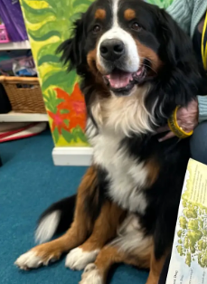
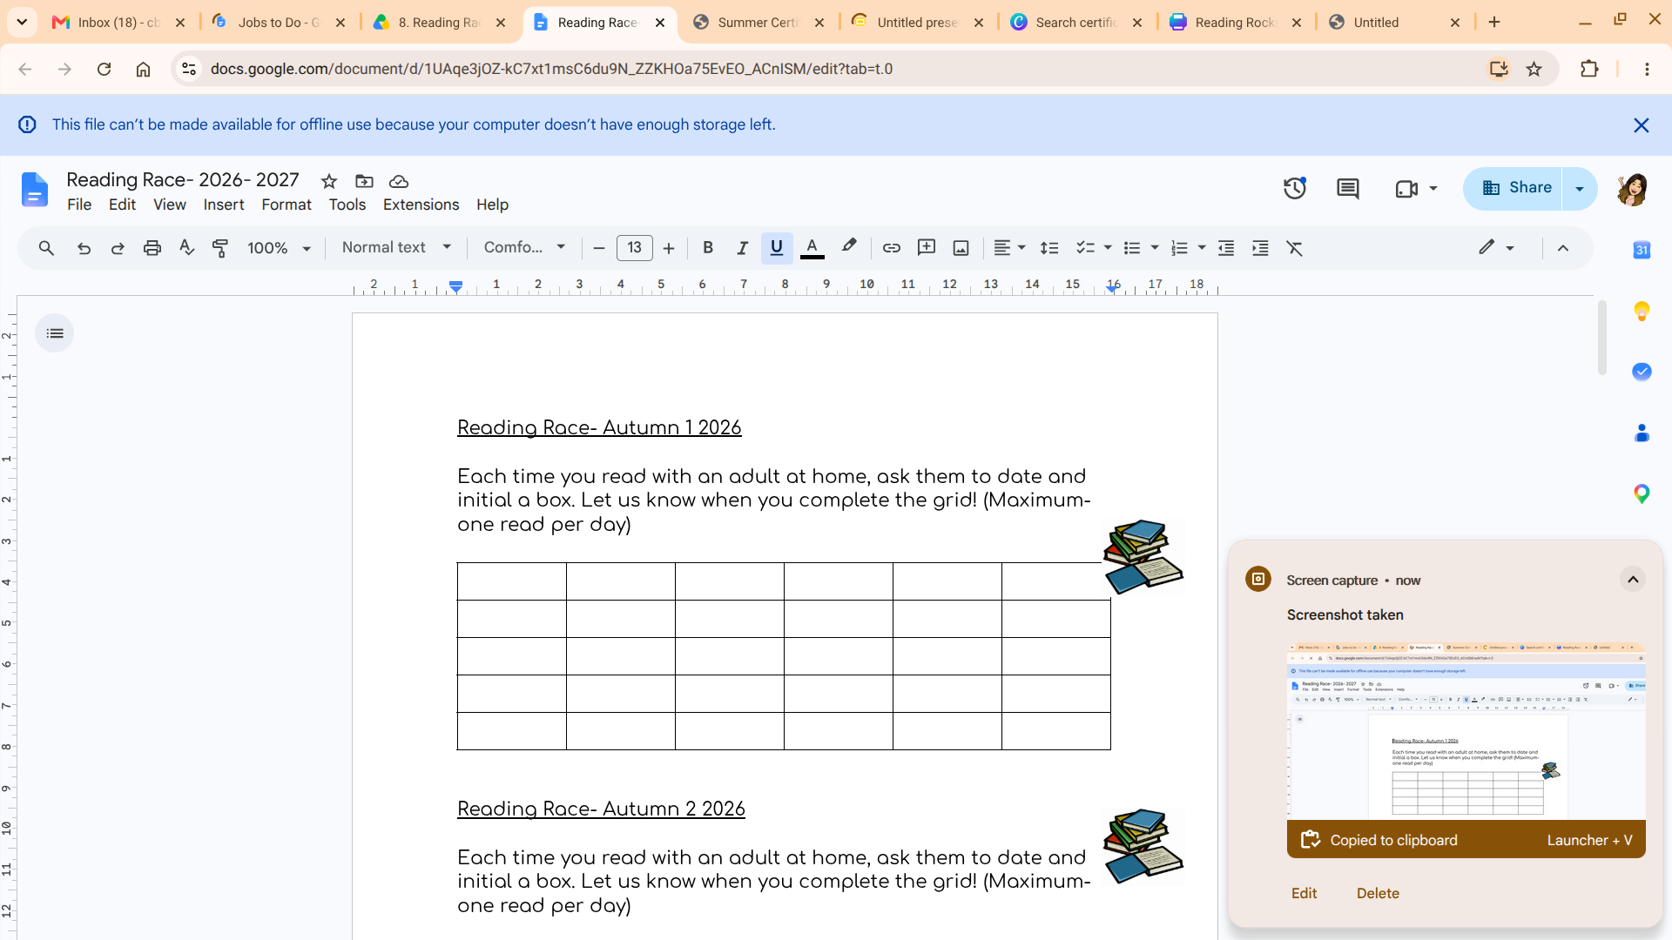

Slide 10
Maths
Automaticity is a whole school focus in Maths. It is the knowledge and rapid recall of number facts. Practice makes perfect and repetition is needed to gain fluency.
The children have all been issued with a login for TT rockstars. Regular practise on here will help them to secure the tables and number facts. We will practise using TT Rockstars in school and will let you know in advance if we set and tournaments/challenges.
Times tables tests will be each Friday.

Slide 11
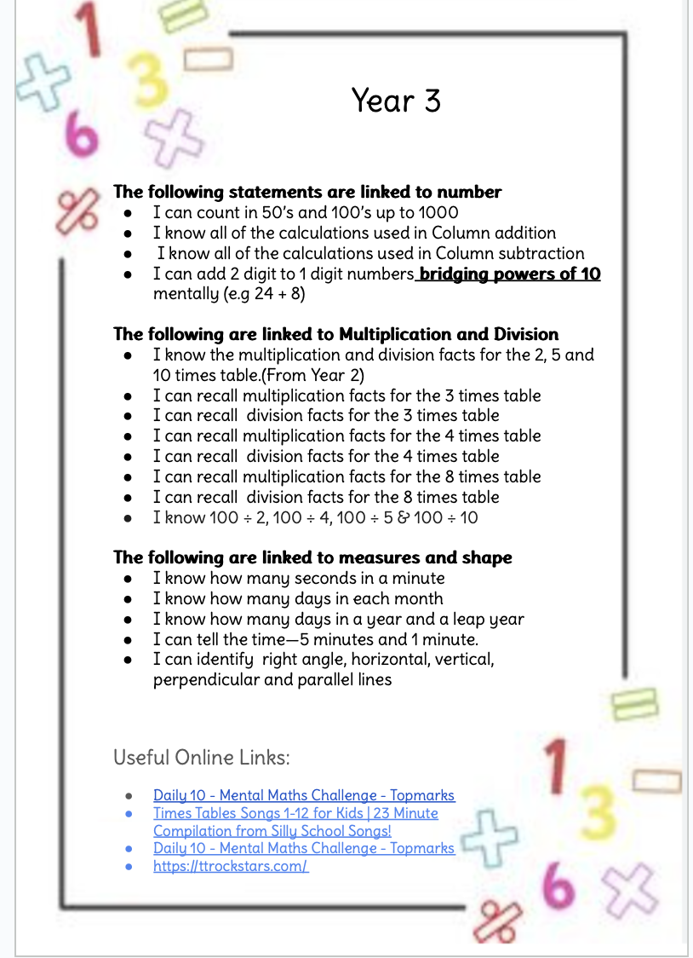

Slide 12
Homework
  Set most Fridays to be handed in by the following Friday.
  Maths and English usually set on alternate weeks.
Other homework
  Y3 spelling list - Spelling shed
  Reading
  Times tables - Times Table Rockstars

Slide 13
Coming up...
Wyvernwood (Wednesday 30th September)
Making Dream Jars (next week!)
Year 3 Trips (potential)
Rayleigh Library
Sealife Centre
Colchester Castle

Slide 14
Contacting us...
Via office
At the end of the school day.
Email (on website)

Slide 15
Volunteers
Volunteers and helpers are always appreciated in year 3.
If anyone is available to give up any of their time please speak/email to the class teacher.
Thanks, the Year 3 team :)

